Slide 1

DYNAMICAL SYSTEMS AND TRAFFIC CONTROL
Invited Guest Lecture in 18.085/18.0851 Computational Science and Engineering I
Claudio Lombardi^{1,2,*}
¹CERIS, Instituto Superior Técnico, Universidade de Lisboa, Av. Rovisco Pais 1, 1049-001, Lisboa, Portugal
²Active Adaptive Control Laboratory, Department of Mechanical Engineering, MIT, Cambridge, MA, USA
Massachusetts Institute of Technology, 12th August 2020
Notes:
Hello everybody; thanks Richard for the introduction.

Slide 2

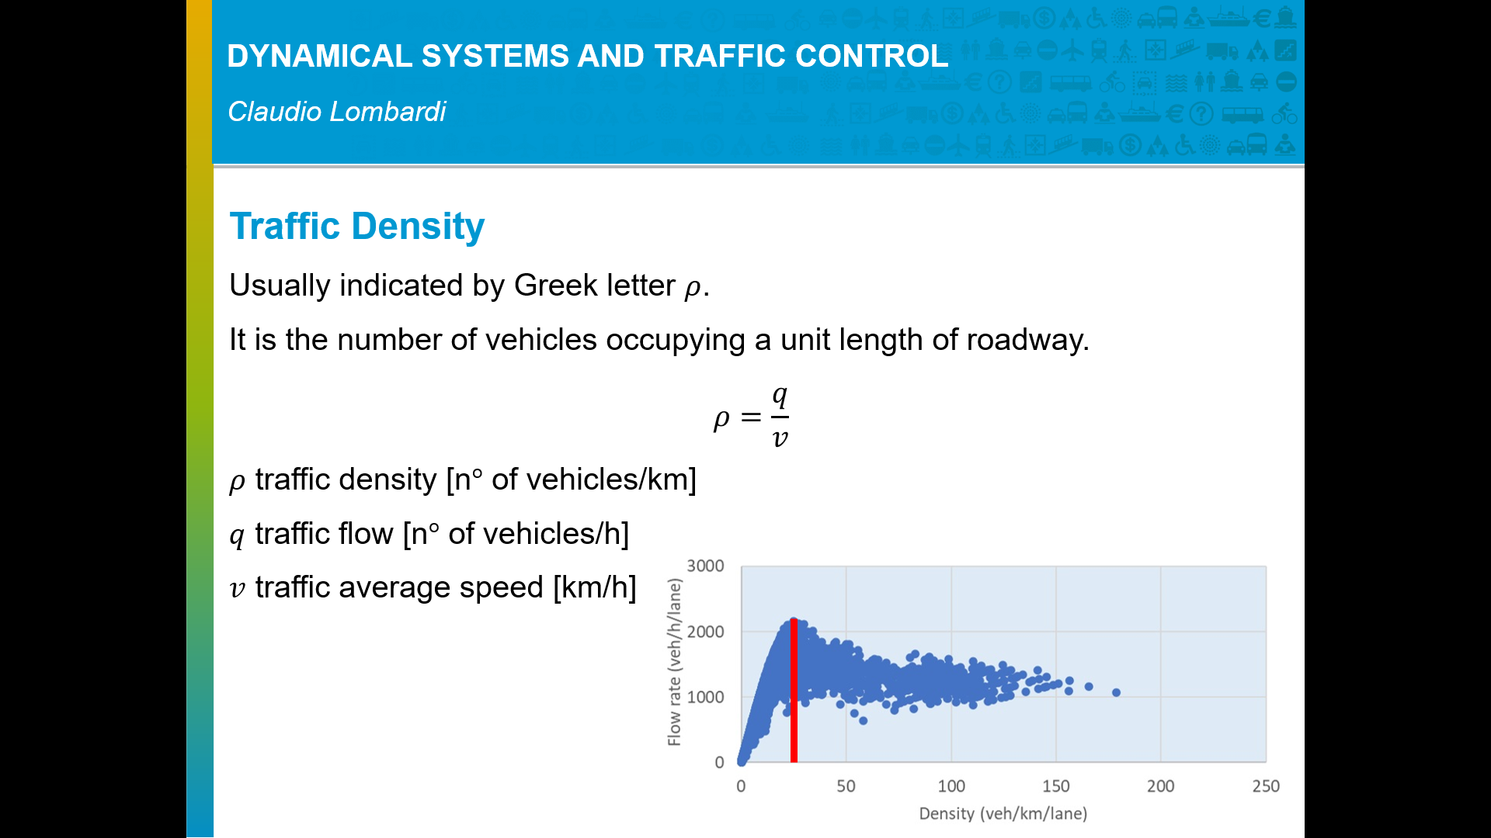
DYNAMICAL SYSTEMS AND TRAFFIC CONTROL
Claudio Lombardi
Claudio Lombardi
2014 B.Sc. degree in Civil Engineering from Politecnico di Milano
2016 M.Sc. degree in Civil Engineering from Politecnico di Milano and IST
2016 - on going Ph.D. in Transportation system at Instituto Superior Técnico (IST)
Oct 2018 – Jan 2019 visiting Ph.D. student at AAC Lab, MIT
Sept 2019 – Apr 2020 visiting Ph.D. student at AAC Lab, MIT
webpage: https://fenix.tecnico.ulisboa.pt/homepage/ist422646
linkedin: https://www.linkedin.com/in/lombardiclaudio/
Notes:
I am Claudio and this is my academic career. As you can see, both my bachelor and master are in civil engineering. In PhD I took a slightly different direction and it is in this period that I came to MIT and got in touch with control engineering. This presentation is very much about my personal understanding of control engineering and its application to traffic. I warn you that sometimes it may be a bit informal or I may be not completely rigorous.

Slide 3
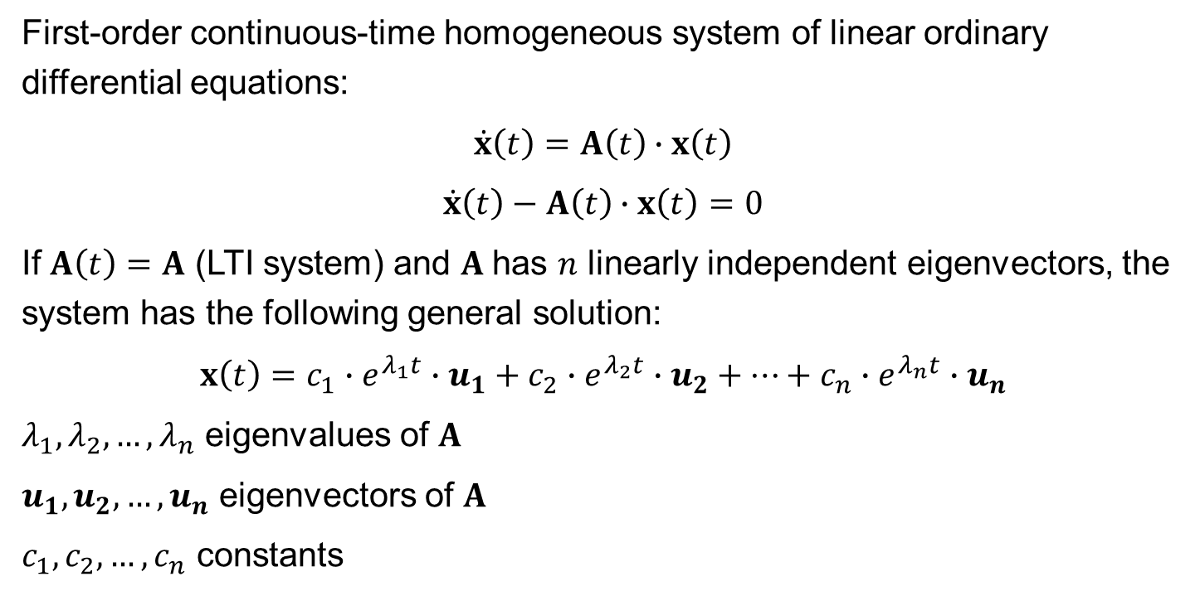
DYNAMICAL SYSTEMS AND TRAFFIC CONTROL
Claudio Lombardi
Dynamical systems
First-order continuous-time homogeneous system of linear ordinary differential equations:
$$\dot{x}\left(t\right)=A\left(t\right)∙x\left(t\right)$$
$$\dot{x}\left(t\right)−A\left(t\right)∙x\left(t\right)=0$$
If $A\left(t\right)=A$ (LTI system) and $A$has $n$ linearly independent eigenvectors, the system has the following general solution:
$$x\left(t\right)=c_{1}∙e^{λ_{1}t}∙u_{1}+c_{2}∙e^{λ_{2}t}∙u_{2}+…+c_{n}∙e^{λ_{n}t}∙u_{n}$$
$λ_{1},λ_{2}, …,λ_{n}$ eigenvalues of $A$
$u_{1},u_{2}, …,u_{n}$ eigenvectors of $A$
$c_{1},c_{2}, …,c_{n}$ constants

Slide 4
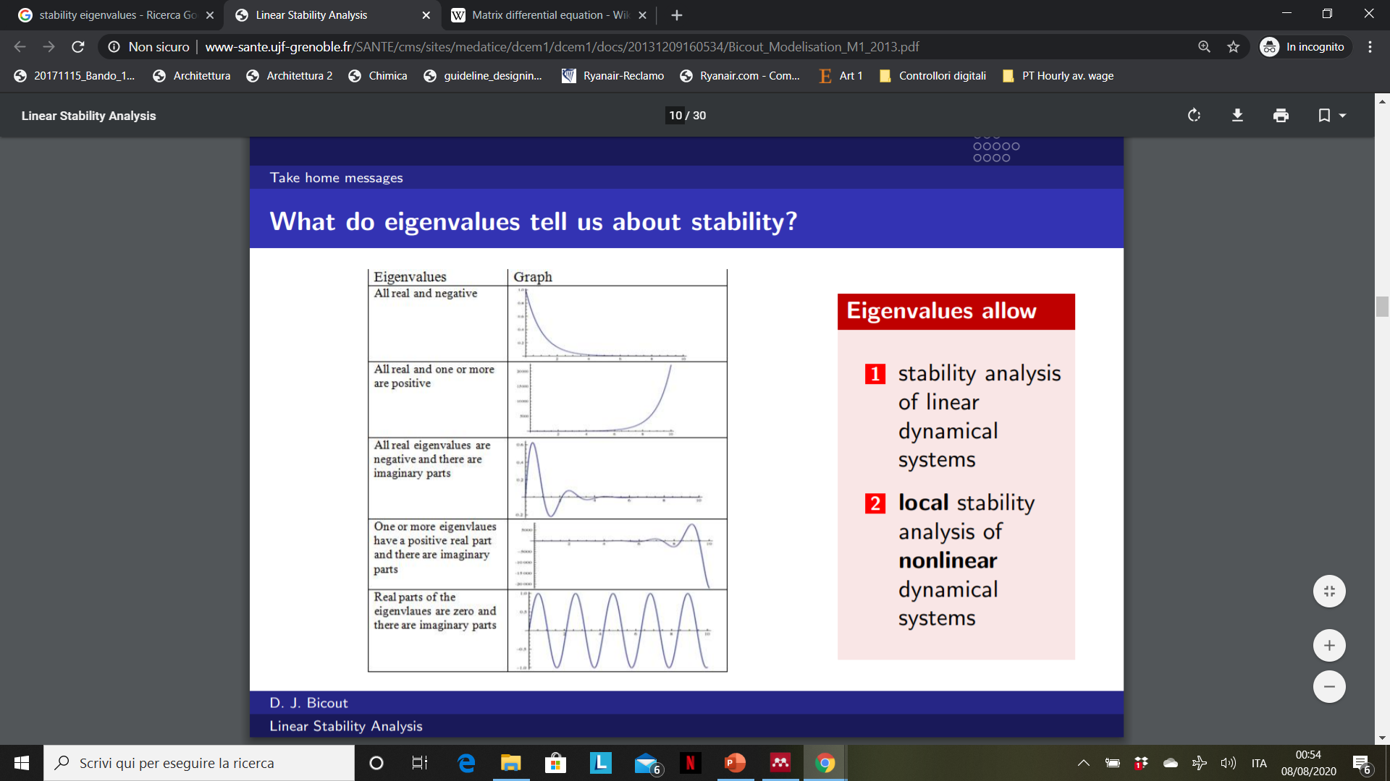

DYNAMICAL SYSTEMS AND TRAFFIC CONTROL
Claudio Lombardi
Stability (one dimensional graph)
$$x\left(t\right)$$
Asymptotically stable
Asymptotically stable (with oscillations)
© Gianni A. Di Caro. All rights reserved. This content is excluded from our Creative Commons license. For more information, see https://ocw.mit.edu/fairuse.
Source: https://web2.qatar.cmu.edu/~gdicaro/15382-Spring18/slides/382-S18-5-DynamicalSystems-4.pdf
Notes:
The eigenvalues of the system influence the behavior of the solution, especially in what concerns its stability.
When the real part of all the eigenvalues is negative, the solution is asymptotically stable. There are oscillations in case the imaginary part of some eigenvalues are not null.
Feedback control theory is built around the study of the characteristics of the solutions of linear systems; stability is a very important property.

Slide 5
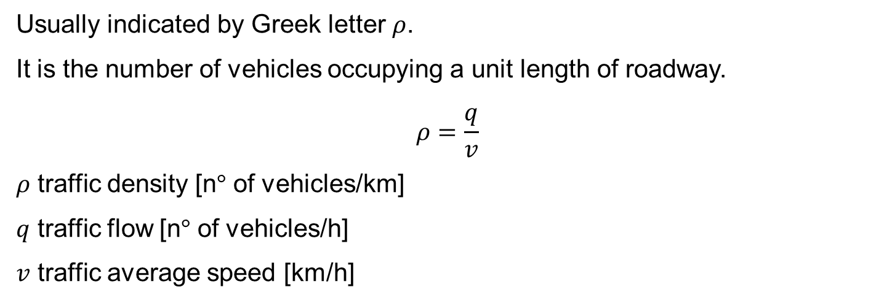
DYNAMICAL SYSTEMS AND TRAFFIC CONTROL
Claudio Lombardi
Traffic Density
Usually indicated by Greek letter $ρ$.
It is the number of vehicles occupying a unit length of roadway.
$$ρ=\frac{q}{v}$$
$ρ$ traffic density [n° of vehicles/km]
$q$ traffic flow [n° of vehicles/h]
$v$ traffic average speed [km/h]
Notes:
This is a typical plot of flow vs density. You can see that, when traffic density increases, flow also increases up to a certain point, where it starts decreasing. The value of density corresponding to the start of the decreasing is called critical density. In traffic engineering we aim to have a traffic situation described by a point on the left side of the diagram, but the density value should not be too far from the critical density, in order to limit underutilization of the full road capacity, so this is the region where we can pick a desired value of density.

Slide 6
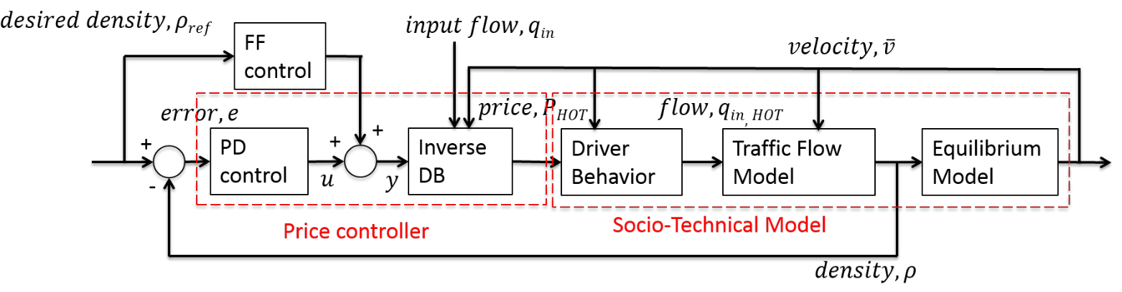



DYNAMICAL SYSTEMS AND TRAFFIC CONTROL
Claudio Lombardi
Traffic control
$\left(e\left(t\right)=0,\dot{e}\left(t\right)=0\right)$ equilibrium point
(Phan et al., 2016):
© IEEE. All rights reserved. This content is excluded from our Creative Commons license. For more information, see https://ocw.mit.edu/fairuse.
$$u=K_{p}∙e+K_{d}∙\dot{e}$$
© Gianni A. Di Caro. All rights reserved. This content is excluded from our Creative Commons license. For more information, see https://ocw.mit.edu/fairuse.
$$\dot{ρ}\left(t\right)=a∙ρ\left(t\right)+b∙ρ_{ref}(t)$$
Notes:
A very important characteristic of traffic is traffic density. Traffic researchers aim to control traffic density, leading it to a neighborhood of the desired value and stabilizing it there. In this slide we can see a diagram representing a traffic control scheme through dynamical toll pricing published by some members of the MIT lab I am collaborating with. Reality is modelled through differential equations for each of the represented blocks. There is a Socio-Technical Model, composed by a model of the Driver Behavior, outputting the number of users entering the facility given the price (incoming flow), a Traffic Flow Model, which transforms incoming traffic flow into traffic density and a equilibrium model, converting traffic density into velocity. Then we pass to the left side of the picture, where we have the part where we represent our intervention on reality. Actual traffic density is confronted with the desired value; their difference produces and error signal, which constitutes the input to a price controller. The price controller physically is a computer taking the error signal as input and outputting the toll value. It is composed by a Proportional Derivative controller and a Feed Forward component which produce y, which represents the desired incoming flow. The PD controller is given by this equation. The parameters of the PD controller are basically the only parameters of the system that are designed by the engineer, whereas the rest is based on reality. The inverse driver Behavior is also part of the price controller. It mirrors exactly the driver behavior of the socio-technical model. The socio-technical model is actually a simulator of reality; in real application density comes from measurements, but in the simulation and for a good choice of the parameters of the PD controller, we can assume y=incoming flows. This allows us to write an equation that describes all the system. If all equations excepts DB and Inverse DB are linear and time invariant (they may be not linear but we cancel them), the closed-loop equation is also LTI. The point characterized by null error and null variation of the error is an equilibrium point of the system, describing a situation where traffic flows constantly at the desired density value.

Slide 7
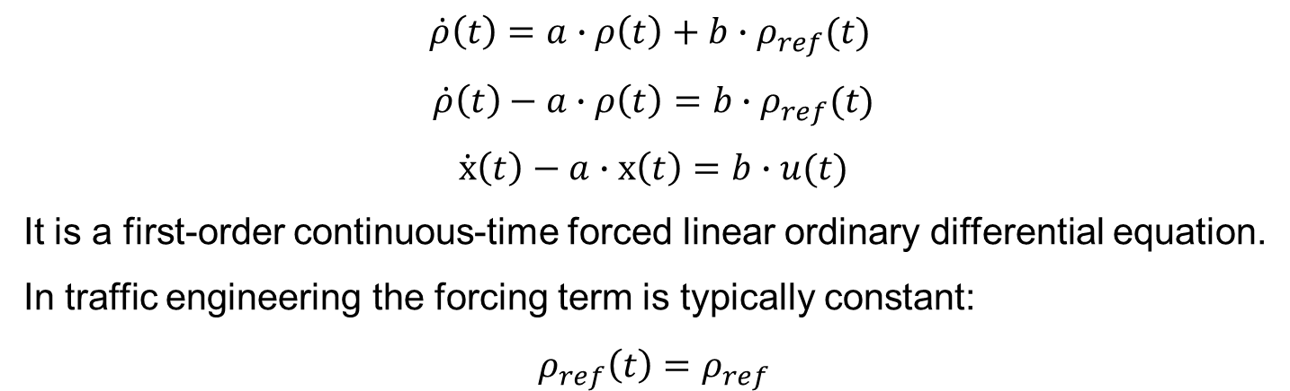
DYNAMICAL SYSTEMS AND TRAFFIC CONTROL
Claudio Lombardi
Traffic control
$$\dot{ρ}\left(t\right)=a∙ρ\left(t\right)+b∙ρ_{ref}(t)$$
$$\dot{ρ}\left(t\right)−a∙ρ\left(t\right)=b∙ρ_{ref}(t)$$
$$\dot{x}\left(t\right)−a∙x\left(t\right)=b∙u(t)$$
It is a first-order continuous-time forced linear ordinary differential equation.
In traffic engineering the forcing term is typically constant:
$$ρ_{ref}\left(t\right)=ρ_{ref}$$

Slide 8
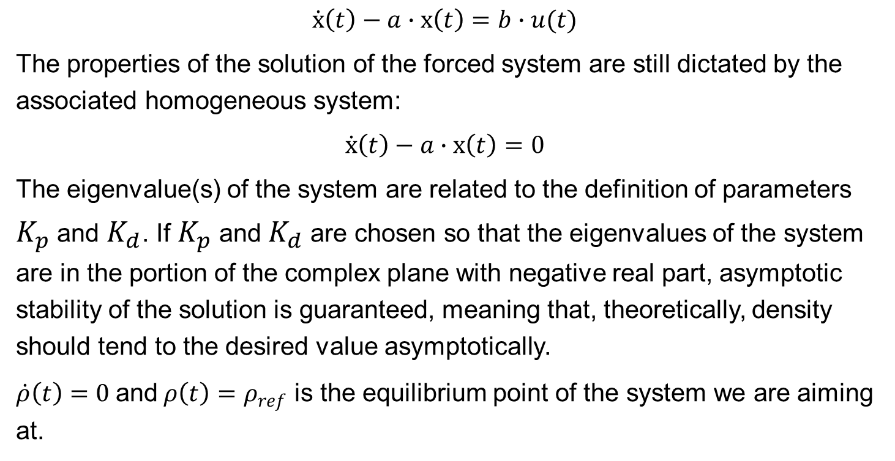
DYNAMICAL SYSTEMS AND TRAFFIC CONTROL
Claudio Lombardi
Traffic control
$$\dot{x}\left(t\right)−a∙x\left(t\right)=b∙u(t)$$
The properties of the solution of the forced system are still dictated by the associated homogeneous system:
$$\dot{x}\left(t\right)−a∙x\left(t\right)=0$$
The eigenvalue(s) of the system are related to the definition of parameters $K_{p}$ and $K_{d}$. If $K_{p}$ and $K_{d}$are chosen so that the eigenvalues of the system are in the portion of the complex plane with negative real part, asymptotic stability of the solution is guaranteed, meaning that, theoretically, density should tend to the desired value asymptotically.
$\dot{ρ}\left(t\right)=0$ and$ρ\left(t\right)=ρ_{ref}$ is the equilibrium point of the system we are aiming at.
Notes:
With a proper choice of the eigenvalues (so, of the control parameters), the system will have a stable behavior around the desired operational point.

Slide 9
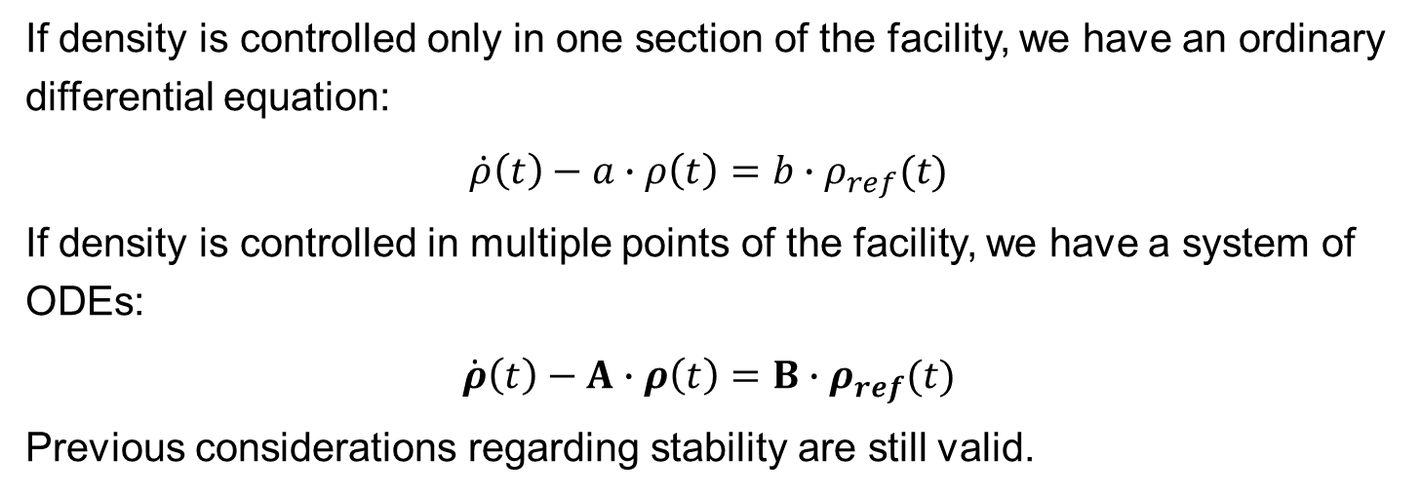
DYNAMICAL SYSTEMS AND TRAFFIC CONTROL
Claudio Lombardi
Traffic control – multiple control sections
If density is controlled only in one section of the facility, we have an ordinary differential equation:
$$\dot{ρ}\left(t\right)−a∙ρ\left(t\right)=b∙ρ_{ref}(t)$$
If density is controlled in multiple points of the facility, we have a system of ODEs:
$$\dot{ρ}\left(t\right)−A∙ρ\left(t\right)=B∙ρ_{ref}(t)$$
Previous considerations regarding stability are still valid.

Slide 10
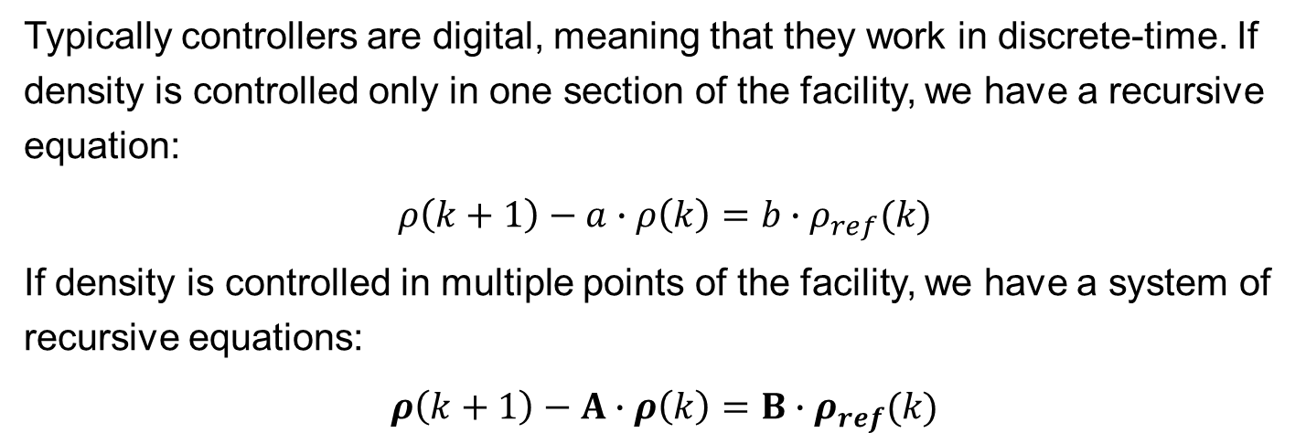
DYNAMICAL SYSTEMS AND TRAFFIC CONTROL
Claudio Lombardi
Digital traffic control
Typically controllers are digital, meaning that they work in discrete-time. If density is controlled only in one section of the facility, we have a recursive equation:
$$ρ\left(k+1\right)−a∙ρ\left(k\right)=b∙ρ_{ref}(k)$$
If density is controlled in multiple points of the facility, we have a system of recursive equations:
$$ρ\left(k+1\right)−A∙ρ\left(k\right)=B∙ρ_{ref}(k)$$

Slide 11
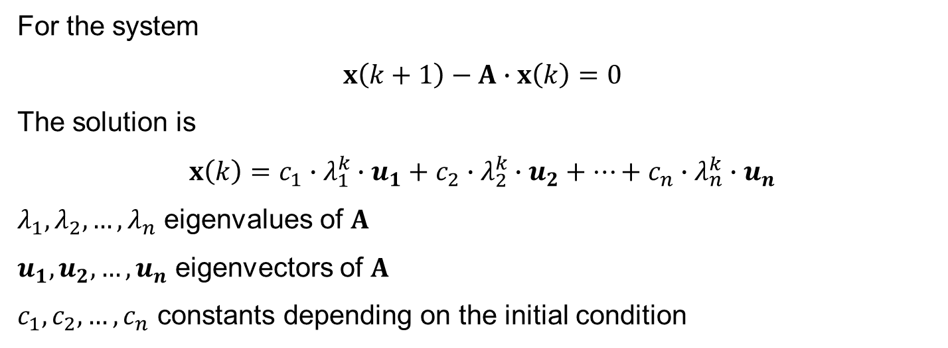
DYNAMICAL SYSTEMS AND TRAFFIC CONTROL
Claudio Lombardi
Digital traffic control
For the system
$$x\left(k+1\right)−A∙x\left(k\right)=0$$
The solution is
$$x\left(k\right)=c_{1}∙λ_{1}^{k}∙u_{1}+c_{2}∙λ_{2}^{k}∙u_{2}+…+c_{n}∙λ_{n}^{k}∙u_{n}$$
$λ_{1},λ_{2}, …,λ_{n}$ eigenvalues of $A$
$u_{1},u_{2}, …,u_{n}$ eigenvectors of $A$
$c_{1},c_{2}, …,c_{n}$ constants depending on the initial condition

Slide 12
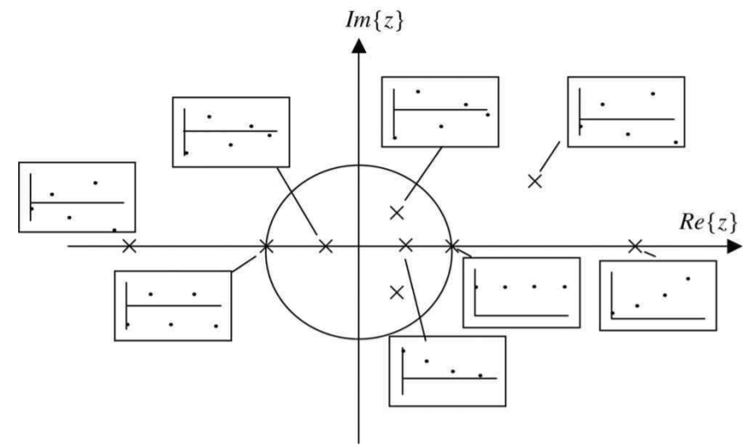
DYNAMICAL SYSTEMS AND TRAFFIC CONTROL
Claudio Lombardi
Digital traffic control
There is stability for eigenvalues that are inside the unit circle around the origin of the complex plane.
Courtesy Elsevier, Inc., http://www.sciencedirect.com. Used with permission.
Source: M. Sami Fadali, and A. Visioli. Digital Control Engineering: Analysis and Design. 3rd ed. Academic Press, 2020.

Slide 13
DYNAMICAL SYSTEMS AND TRAFFIC CONTROL
Claudio Lombardi
References
T. Phan, A. M. Annaswamy, D. Yanakiev, and E. Tseng, “A model-based dynamic toll pricing strategy for controlling highway traffic,” in Proc. Amer. Control Conf. (ACC), 2016, pp. 6245–6252.
M. Sami Fadali, and A. Visioli. Digital Control Engineering: Analysis and Design. 3rd ed. Academic Press, 2020.

