Slide 1
MODELING OF OSCILLATING WATER COLUMNS
Wave Energy Generation
Jorge Manuel Marques Silva

Slide 2

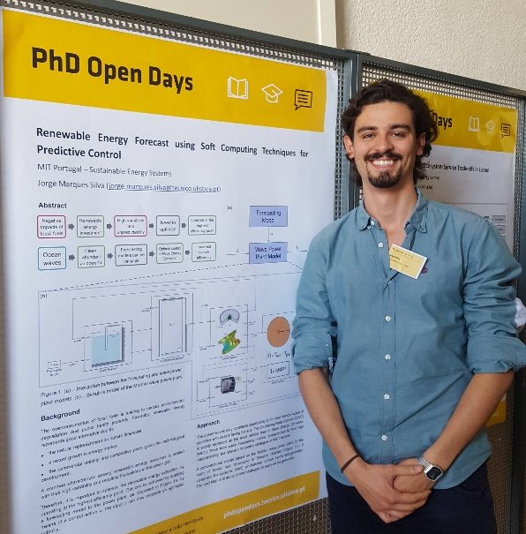
Background
  Bachelor + Master in Electrical Engineering (Energy) in 2015;
    Superconductors in Electrical Machines;
  Started MIT Portugal PhD Program – Sustainable Energy Systems in 2017:
    Renewable Energy (Ocean Waves);
    Machine Learning Forecasting;
    Predictive Control.

Slide 3
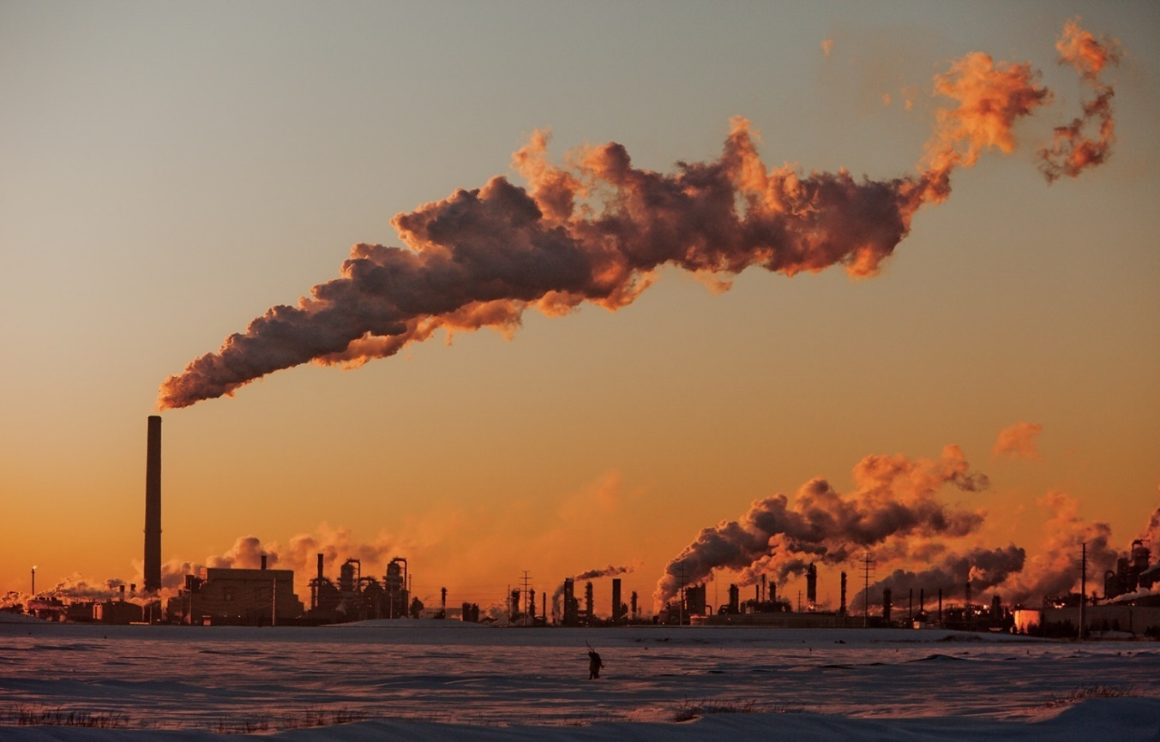
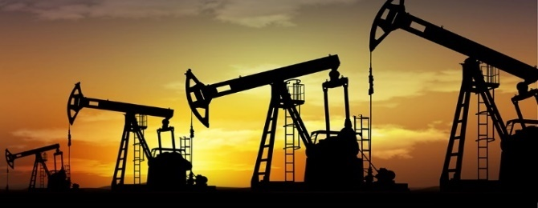
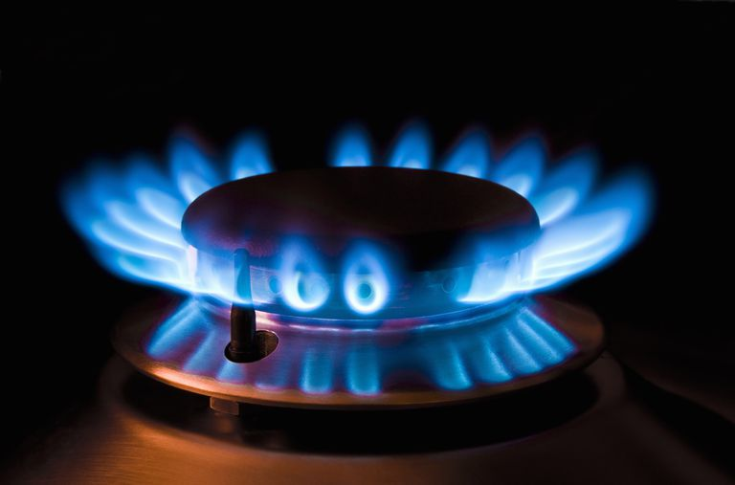
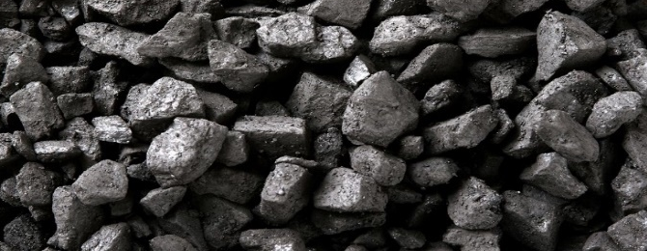
Motivation
  Fossil fuels:
    Cheap and reliable;
    Available and easy to find;
    Environmental degradation;
    Public health issues;
    Limited energy source – depleting at fast rate.
Notes:
As we all know, the world is facing a number of challenges related to energy sustainability and security. Fossil fuels, such as oil, natural gas and coal, are still the major energy source that is being used in the world today. Why is that? Mainly because of their cheap price, reliability, they are also quite available and easy to find in our planet.
However, their overconsumption is leading to serious environmental degradation. When burnt, fossil fuels release carbon dioxide, and other toxins that can have severe consequences in the ecosystems and in public health in general.
Furthermore, they are non-renewable sources of energy as they are derived from pre-historic fossils and won’t be available once they are totally used. Their sources are thus not only limited but also depleting at a fast rate.

Slide 4

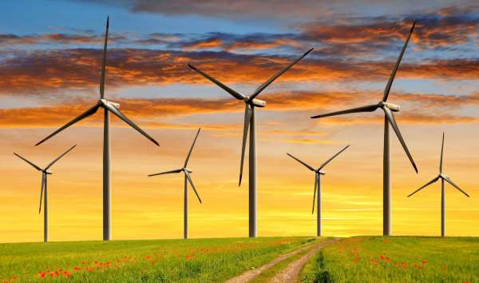
The Alternative
  Renewable energy resources:
    Natural replenishment on human timescale – sustainable;
    Competitive prices;
    Small scale (household) or large scale (city);
    Dependent on environmental variables.
Notes:
Given all this problems, there has been an increasing interest in developing alternative and more sustainable energy sources.
Renewable energies like solar photovoltaic (PV), wind power represent a good alternative specially due to their natural replenishment on human timescale, therefore, sustainable.
Secondly, the use of renewables has been growing rapidly in energy market. Many countries and companies are seeking to diversify their energy mix by increasing their share of renewables, also due technological development that makes it commercially viable and price-competitive.
Harnessing energy from renewable sources can range from small scale (a single household) to large scale (power plants providing energy to an entire city).
However, one of the common drawbacks among renewable power plants is that power generation is dependent on environmental variables which cannot be fully controlled or planned for in advance.

Slide 5
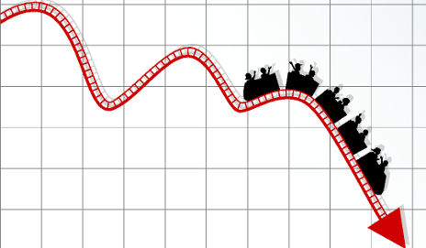
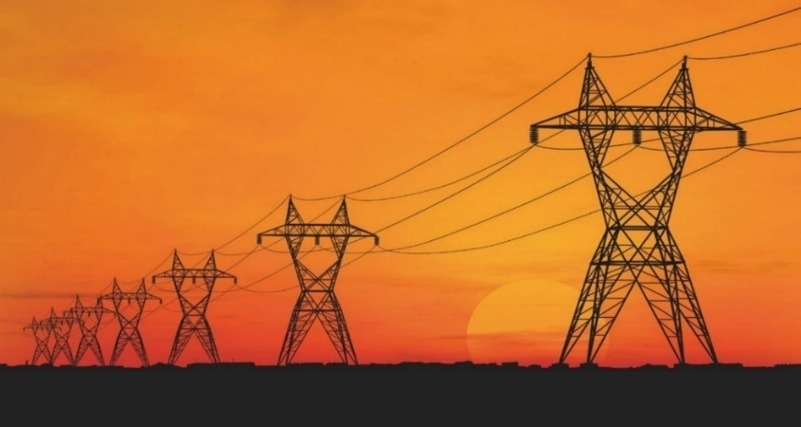
The Problem
  Uncertainty:
    Fluctuations in capacity can have negative impacts;
    Power plants lack optimal sizes, locations and configurations;
    Market’s instability.
Notes:
So, we have a good sustainable alternative, but the main problem is still this dependency on uncertainty.
Why is this bad? Because fluctuations in capacity or quality can have negative impacts on the physical health of the power grid as well as the quality of life of its users.
Moreover, lack of information prevent studying power plants optimal sizes, locations and configurations.
Finally, uncertainty causes fear which in turn contributes to market’s instability.

Slide 6





The Idea
  Machine Learning:
    Learn and improve from experience without explicit programming;
    Environmental variables forecast.
Notes:
So the idea is make use of Machine learning in other to overcome these problems.
Machine learning is a branch of computer science where algorithms have the ability to learn and improve from experience, without being explicitly programmed.
For this reason these techniques represent a very powerful tool in terms of forecasting, in this case those uncertain environmental variables.

Slide 7
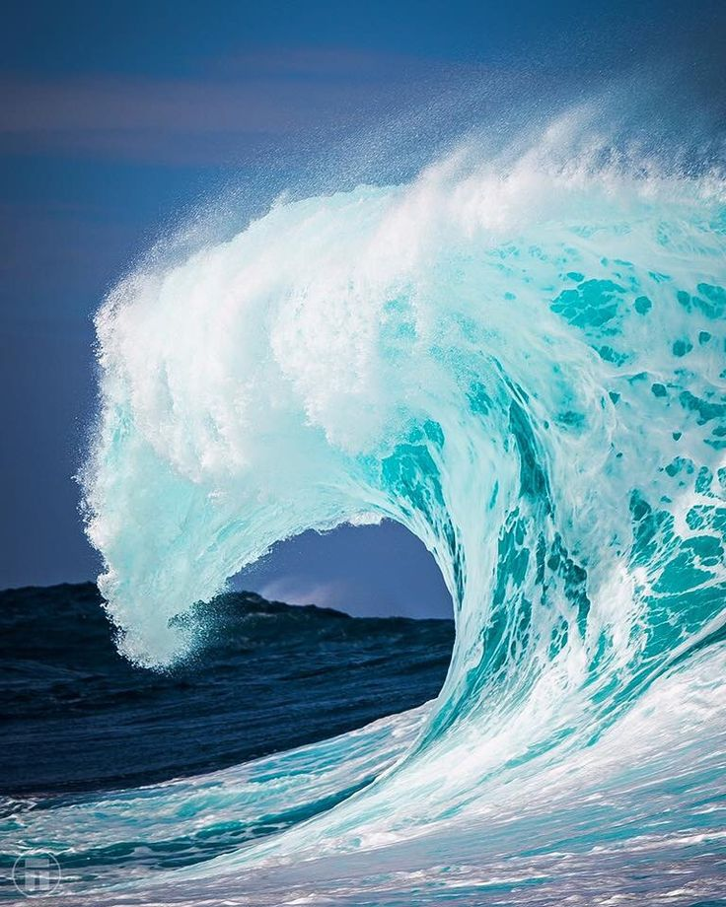
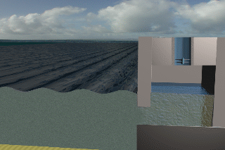
Introduction
  Oscillating Water Column (OWC):
Air chamber
Turbine

Slide 8
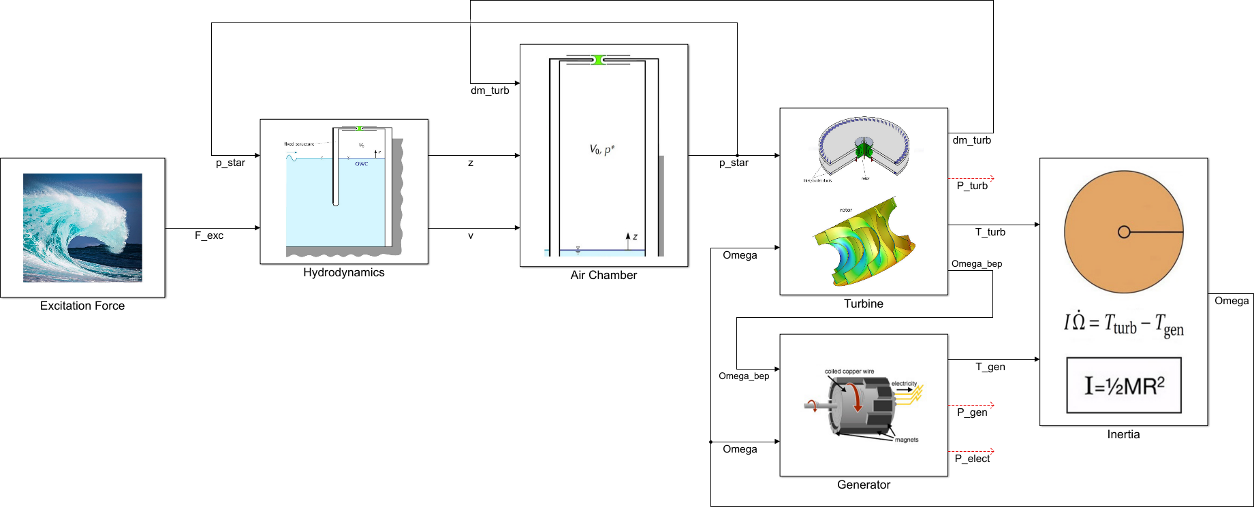
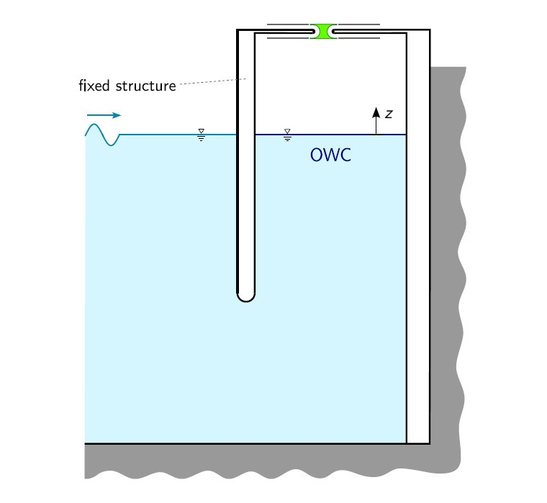
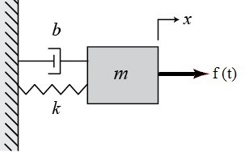
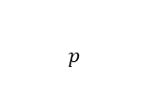


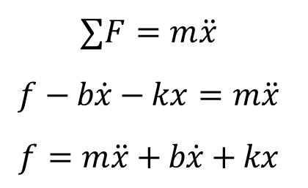
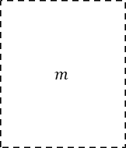
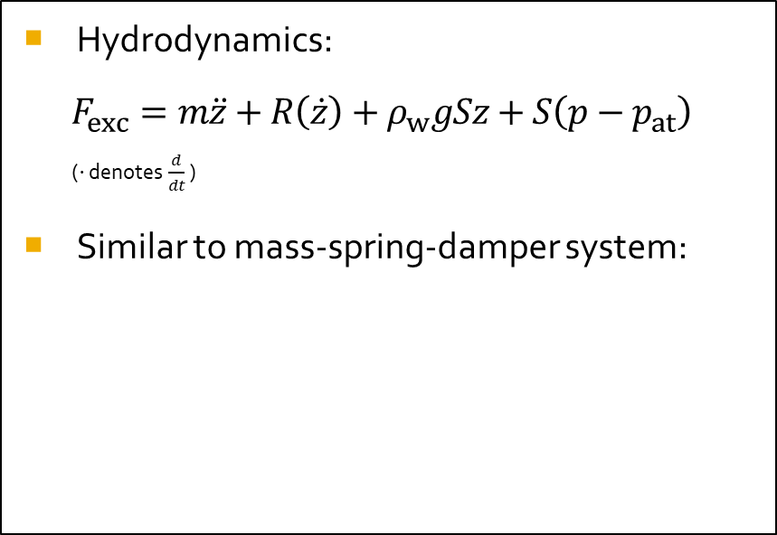
Computational MODEL
  Hydrodynamics:
  $$F_{exc}=m\ddot{z}+R\left(\dot{z}\right)+ρ_{w}gSz+S\left(p−p_{at}\right)$$
  ($⋅$ denotes $\frac{d}{dt}$ )
  Similar to mass-spring-damper system:
$$p$$
$$F_{exc}$$
$$R$$
$$m$$
  $$∑F=m\ddot{x}$$
  $$f−b\dot{x}−kx=m\ddot{x}$$
  $$f=m\ddot{x}+b\dot{x}+kx$$

Slide 9
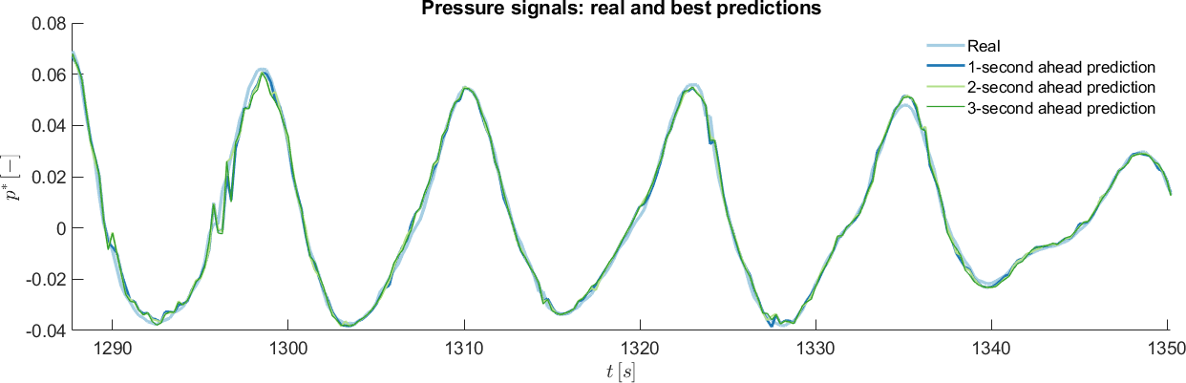
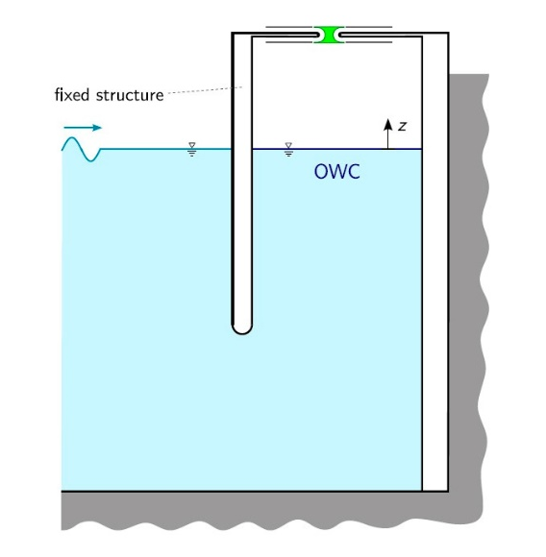
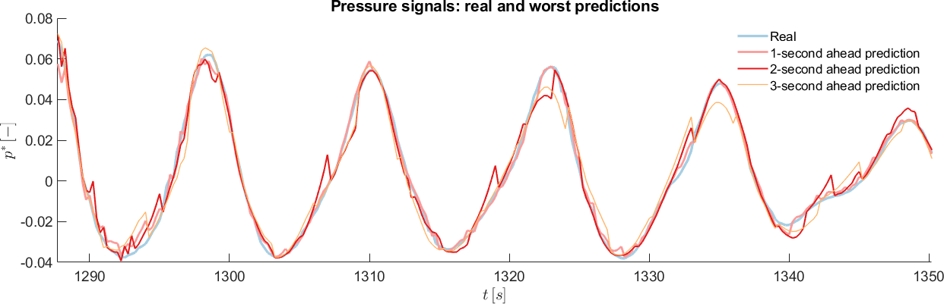

Results
  Forecasting:
    Air chamber pressure;
    Support Vector Machines.
$$p^{∗}$$

Slide 10
THANK YOU!

